Slide 1


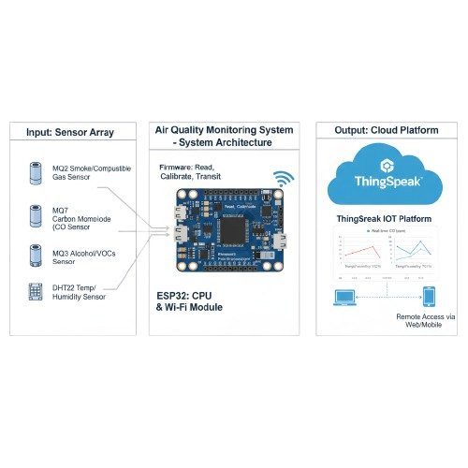



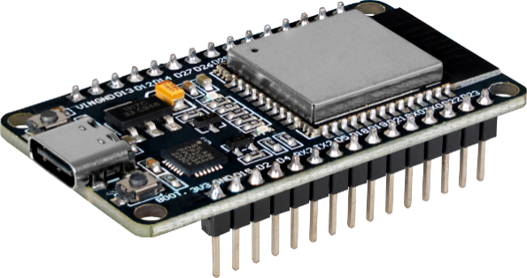
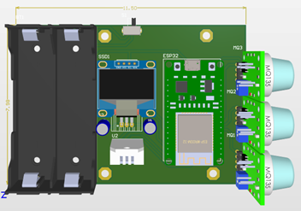
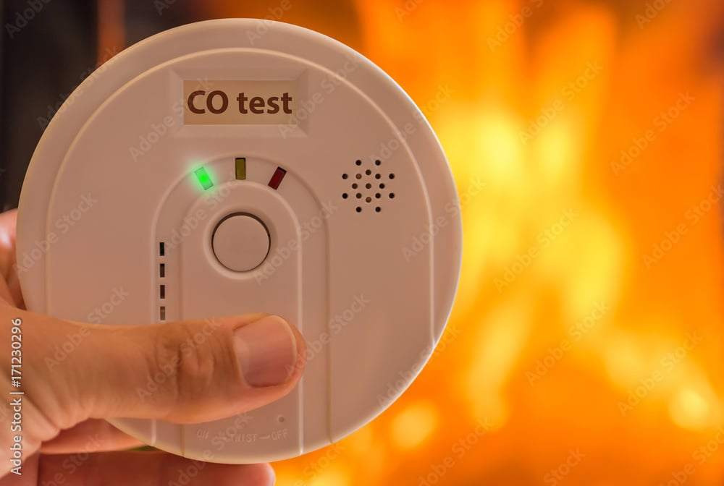
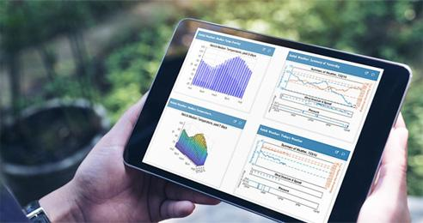
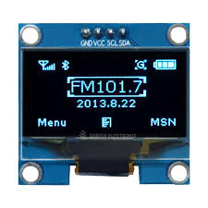
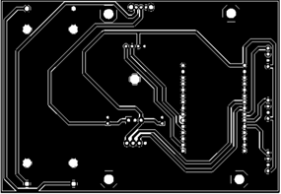
Successfully achieved high-precision monitoring with instant cloud synchronization and local display alerts.
Lê Hoàng
Air Quality Monitoring
I. Idea
III. System Architecture
Concept: An IoT-based atmospheric monitoring station for real-time air quality tracking.
Core Technology: Uses an ESP32 microcontroller to aggregate data from multiple gas sensors and stream it to the ThingSpeak cloud via Wi-Fi.
Input: Multi-sensor array (MQ series + DHT22) captures environmental variables.
Process: ESP32 digitizes signals, applies calibration, and manages Wi-Fi protocols.
Output: Cloud-based dashboard on ThingSpeak for real-time monitoring and trend analysis.
II. Objectives
Comprehensive Detection: Monitor smoke, CO, volatile gases, temperature, and humidity simultaneously.
Data Visualization: Convert raw sensor voltages into easy-to-read historical line charts.
Accessibility: Provide a low-cost tool for smart homes, education, and environmental research.
IV. Innovation
V. Results
Multi-Parameter Tracking: Detects a wide spectrum of pollutants in a single compact device.
Cloud-First Design: Eliminates the need for local storage, allowing remote access from any device.
Scalability: Optimized for future integration of advanced calibration and mobile app alerts.
Current Status: Hardware and PCB are fully functional; firmware ensures reliable data transmission at fixed intervals.
  Thiết bị này sử dụng loại bức xạ điện từ nào?
  Đặc điểm của nó là gì?
Low Cost: High performance at a fraction of the price of industrial meters.
Smart Calibration: Automatic temperature compensation for stable readings.
Versatility: Scalable for home use, aquaculture, and environmental protection.

